Slide 1
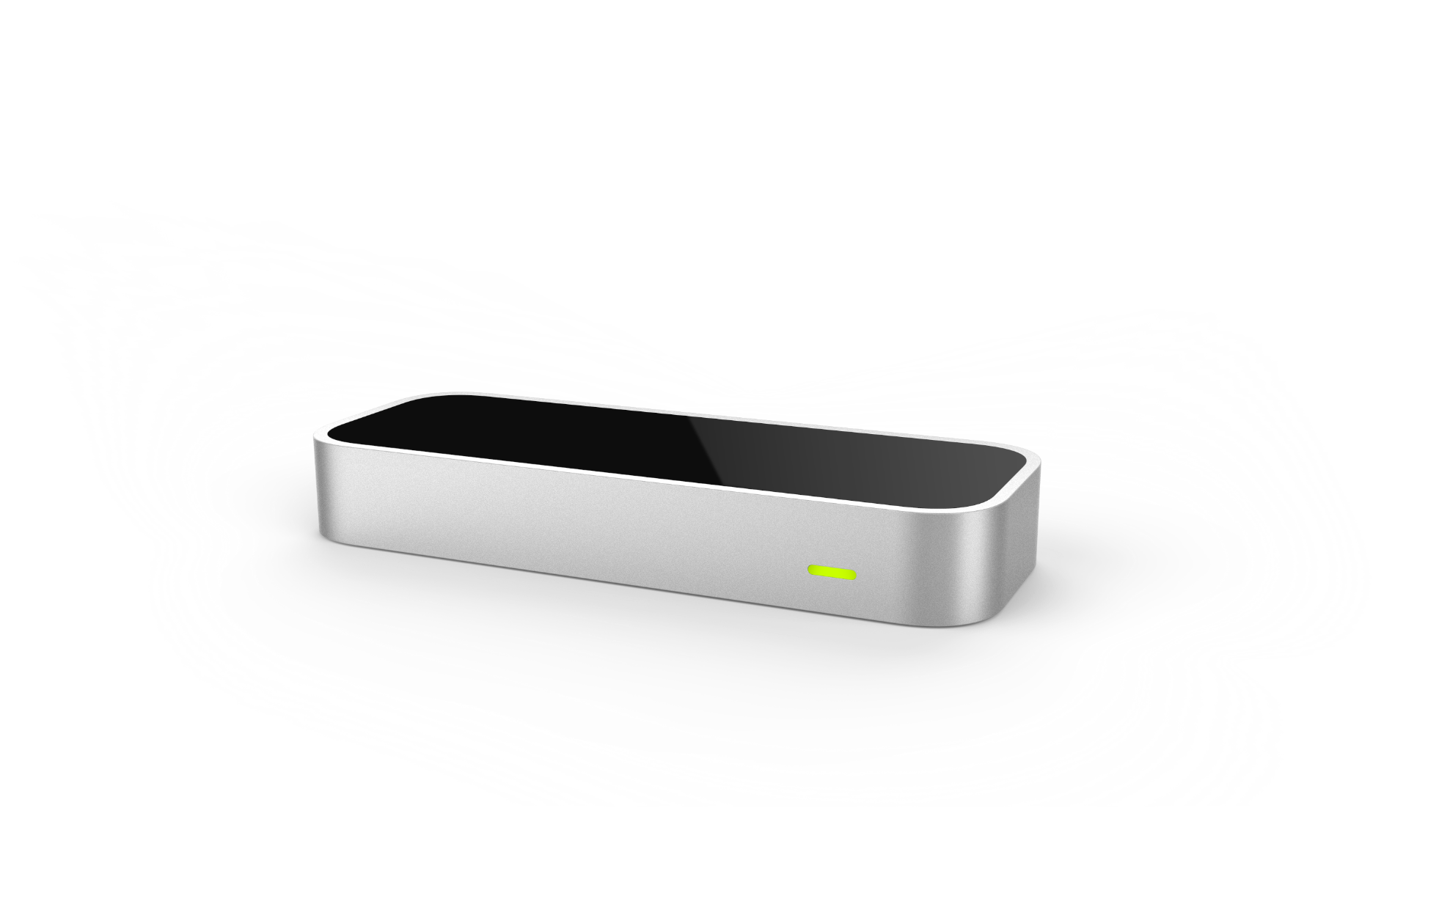
Leap Motion
Michael McCain
3/21/2014
Notes:
Hello
My name is Michael McCain
Today I’d like to tell you about The Leap Motion Controller.
It’s a cool new piece of 3D motion capture technology that I’ve been working with for about a year in my role as a researcher at BYU.
This is some of the most fun I’ve had, so I want to see if can transfer my excitement about it to you.
0:30

Slide 2
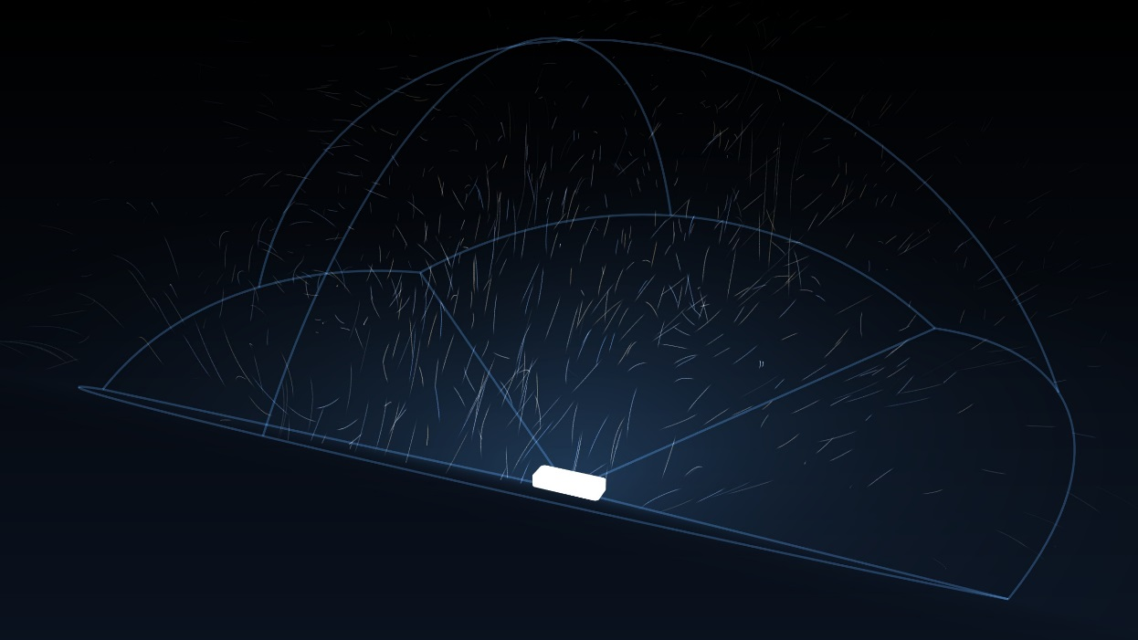
Overview
What is the Leap Motion?
Capabilities
The Leap in Neuromechanics
Programming with the Leap
Benefits

Slide 3
What is the Leap Motion?
“The Leap Motion Controller tracks both hands and all 10 fingers with pinpoint precision and incredible speed. That wide-open space between you and your computer is now yours—to play, create and explore. Reach into another world without actually touching anything.”
- Leap Motion Website
Notes:
*Show physical unit*
Input device much like a mouse or a keyboard, complete with USB
Sits on your desk between screen and user
Some laptops now have it built in next to the keyboard

Slide 4
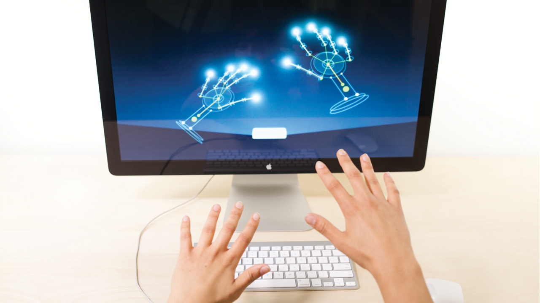
What is the Leap Motion?
Notes:
It’s like an Xbox Kinect compressed and specialized to gather information about hands and pen-like tools, and not watching you 24-7 and sending the feed to the NSA
Infrared and optical cameras triangulate and calculate a bunch of stuff.
Controller detects things like finger position, speed, gestures, angles. And reports it to whatever software wants to use it

Slide 5
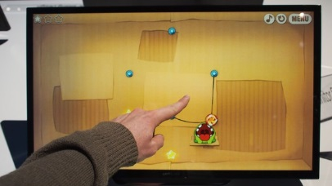
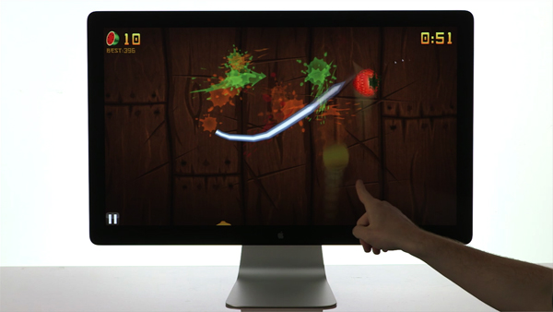

Notes:
I mentioned software that uses the data the controller supplies.
Airspace works much like the app store for Leap applications
Active development community, making independent applications like painting apps or games, fruit ninja and cut the rope and google earth
Google Earth +Leap Motion I believe you don’t actually have to go through Airspace, but it’s an addon
tony stark style cad work

Slide 6
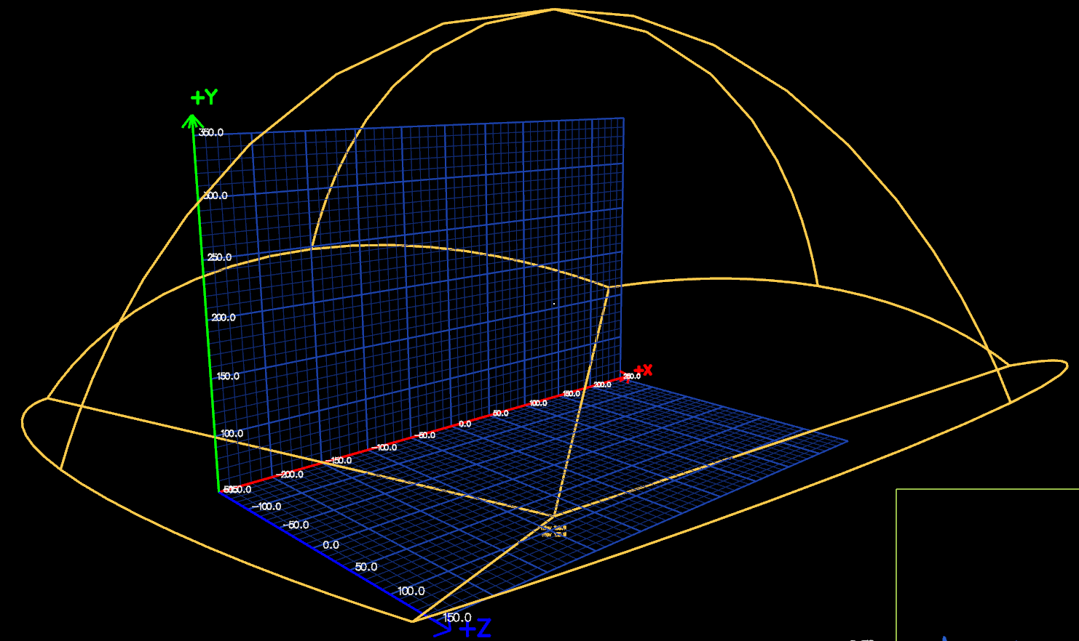
Capabilities as an Instrument
1/100th of a millimeter resolution
Captures up to 200 frames per second
150° field of view
60 frames of internal memory
Notes:
People make some fun games with it, but I want to actually focus on its data gathering capabilities
This thing can see differences in position as fine as 1/00th of a millimeter depending on lighting and motion speed.
It can deliever data at 200 Hz! That’s with perfect ambient lighting. I find it’s closer to about 100 under average conditions, but that’s still pretty impressive for most applications relating to the hand. So 200 times a second, it’s taking a 3D picture of the space above it and running its calculations to report the data
That 150 field of view refers to the inverted pyramid that is the devices interaction area. It’s about a 2 foot cube of reliable interaction area
While its running it keeps 60 frames in short term memory to calculate things like velocity, gestures, trajectories

Slide 7


The Leap in BYU Neuromechanics Research
1.7 million traumatic brain injuries annually
22% develop movement disorders such as tremors, paralysis, or involuntary jerking
Tremor by far most common
Tremor falls into three main categories:
Postural
Kinetic
Intention
Notes:
So after seeing the kind of potential this held as an instrument and not just a novelty item, the professor running my lab got really interested
The BYU neuromechanics research group studies the relationship between brain signals and activity and mechanical movement, especially of the hands.
My part in his research is movement disorders caused by traumatic brain injury
1.7 mil
22% develop movement disorders, many are mild and transient lasting just a weeks or months, but in cases of severe brain injury, these can be persistent
Tremor is the most common disorder caused by tbi, and it falls largely into three groups
GO back a slide
So we want to study tremor on a quantifiable basis, and in the past weve had these clunky apparatuses that have had a lot of trouble measuring movement without interfering with it.
Along comes the leap. Capable of reporting very fine movements without any interference.

Slide 8
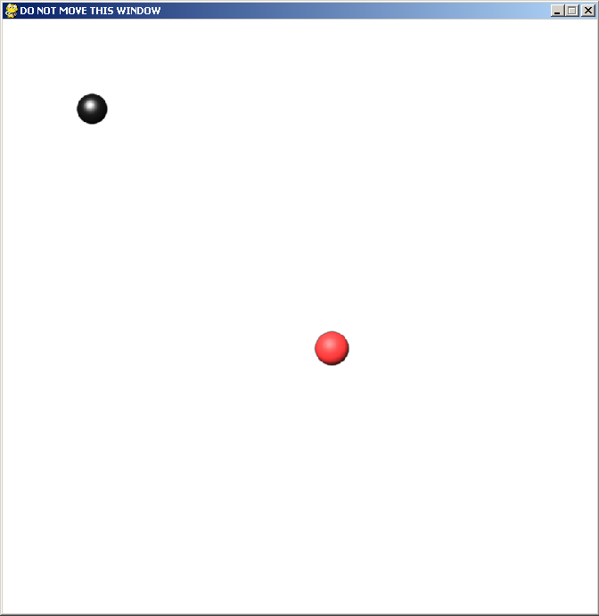
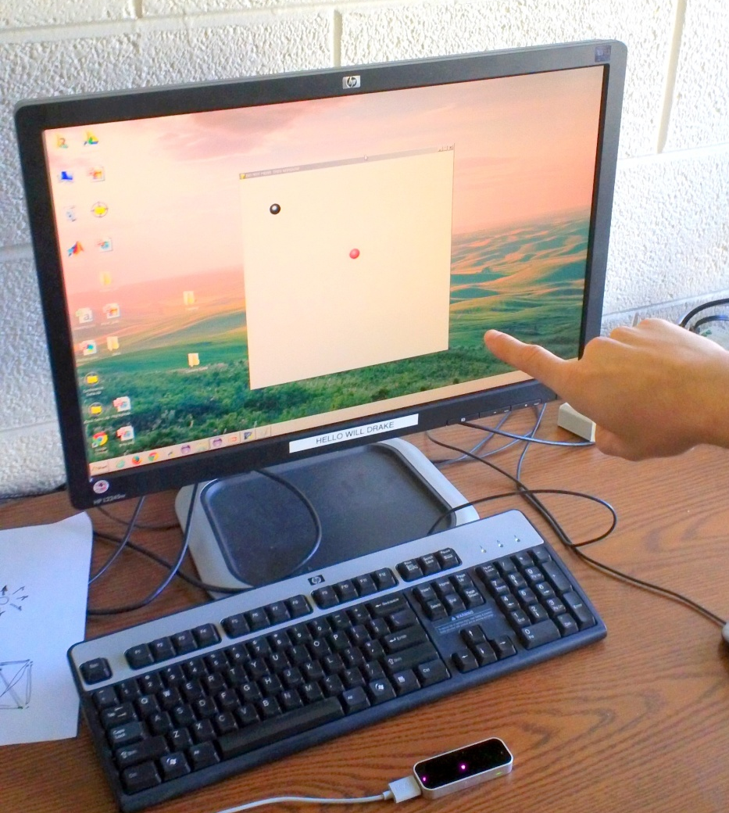
The Leap in BYU Neuromechanics Research

Slide 9
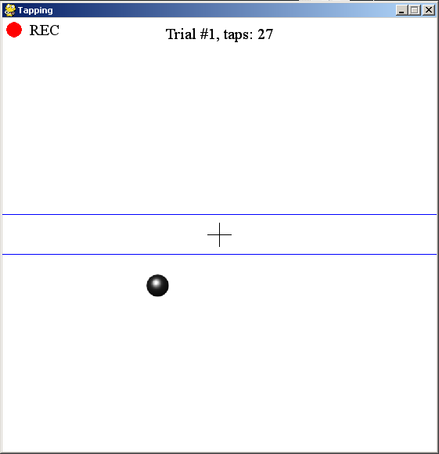
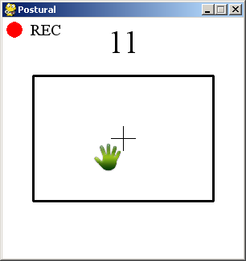
The Leap in BYU Neuromechanics Research

Slide 10
The Leap in BYU Neuromechanics Research

Slide 11
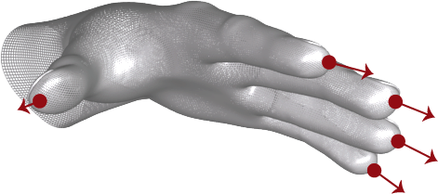
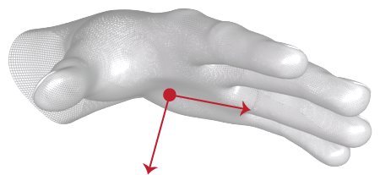
Programming with the Leap
Supports C++, C# and Unity, Objective-C, Java, JavaScript, and Python
Freely available SDK
Active development community and support staff
Complete API and documentation

Slide 12
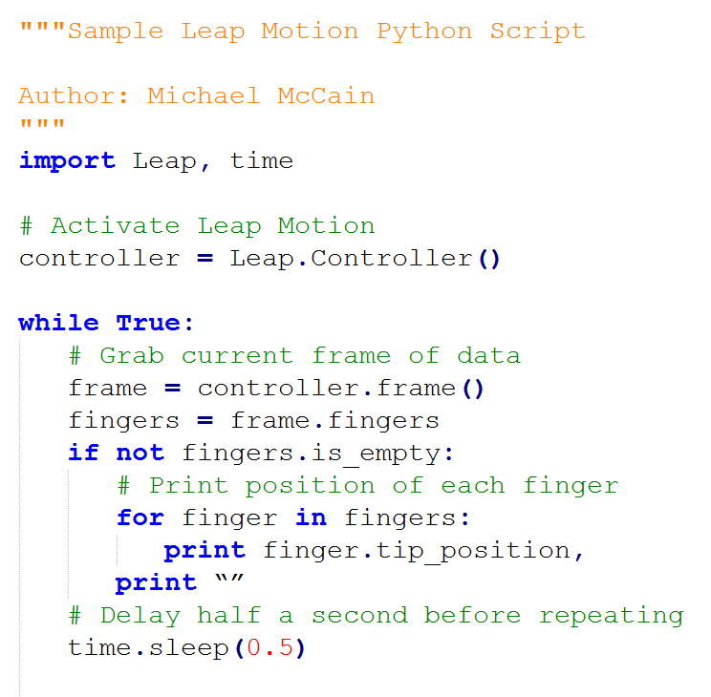
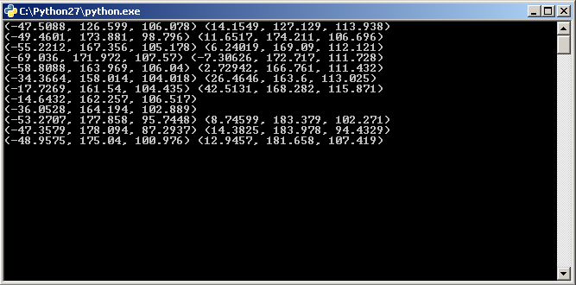
Programming with the Leap

Slide 13
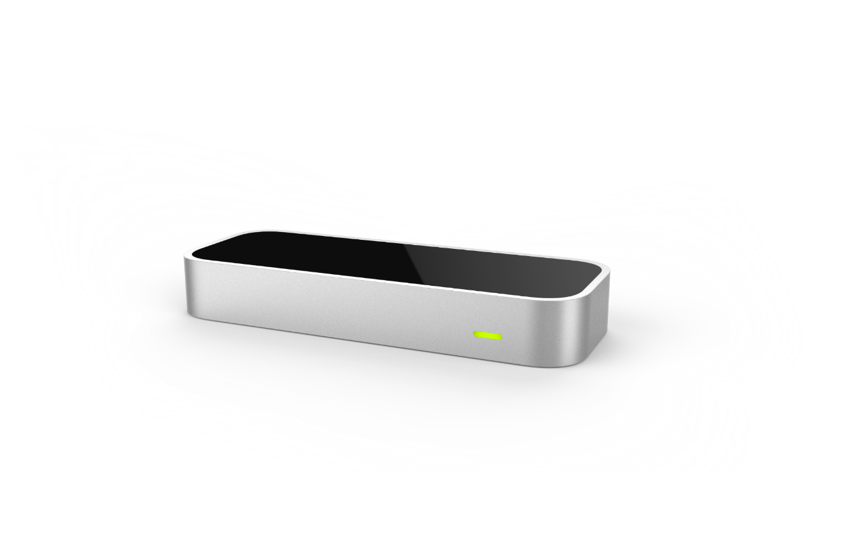
Benefits
Price tag: $79.99
Active support team
Complete API and documentation
Portable
Expanding market

Slide 14
Questions?

